Slide 1
Service Layer and Spring Framework

Slide 2
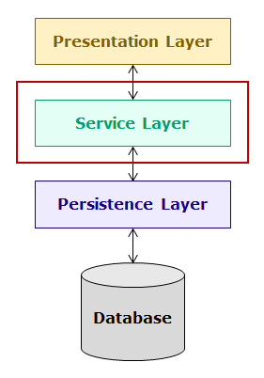
Introduction to Service Layer
The service layer of an enterprise application is the layer in which the business logic is implemented. It is the heart of enterprise applications as it contains the business processes of the application. It interacts with the presentation layer and the persistence layer. In this course, you will learn the development of service layer of enterprise applications using Spring Boot.

Slide 3
In this course, you will understand the concepts of Spring Boot and service layer by developing a banking application named hndBank containing multiple modules. One of the modules of this application is the Customer module and one of the most common feature of any application and also this application is that the customer should be able to login to the application using valid credentials.
To login, the business logic is to validate the credentials entered by the customer against the details stored in the database. On successful validation, the customer should be allowed to use the application. If credentials are invalid, error page should be displayed.
To implement this functionality of login, the following classes need to be implemented in the application:
UserInterface – The customer will interact with the application using a web-based user interface. This interface will interact with the CustomerLoginController class. In this course, for simplicity, the web interface will be replaced with this class.
CustomerLoginController – This class will interact with the user interface and the CustomerLoginServiceImpl class of service layer.

Slide 4
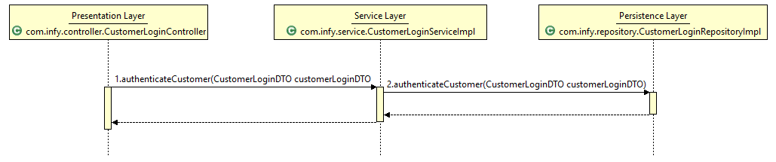
CustomerLoginServiceImpl – The business logic will be implemented in this class. It will interact with the CustomerLoginController of the presentation layer and CustomerLoginRepositoryImpl class of the persistence layer.
CustomerLoginRepositoryImpl – This class is a persistence layer class and will interact with the database and CustomerLoginServiceImpl class of service layer.
CustomerLoginDTO – This is a DTO (Data Transfer Object) class which is used to transfer data across different layers.
When the customer enters the login credentials, the data will flow from CustomerLoginController to CustomerLoginServiceImpl and then to CustomerLoginRepositoryImpl class as follows:

Slide 5
The implementation of the various classes are as follows:
1. CustomerLoginDTO class
package com.hnd.dto;
public class CustomerLoginDTO {
private String loginName;
private String password;
//getter and setter methods
}
2. CustomerLoginRepository interface
package com.hnd.repository;
import com.hnd.dto.CustomerLoginDTO;
public interface CustomerLoginRepository {
public CustomerLoginDTO getCustomerLoginByLoginName(String loginName);
}

Slide 6
3. CustomerLoginRepositoryImpl class
package com.hnd.repository;
import java.util.HashMap;
import java.util.Map;
import com.hnd.dto.CustomerLoginDTO;
public class CustomerLoginRepositoryImpl implements CustomerLoginRepository {
public CustomerLoginDTO getCustomerLoginByLoginName(String loginName) {
Map<String, String> customerCredentials = new HashMap<String, String>();
customerCredentials.put("robin", "robin123");
customerCredentials.put("harry", "harry123");
customerCredentials.put("garry", "garry123");
customerCredentials.put("monica", "monica123");
CustomerLoginDTO customerLogin = new CustomerLoginDTO();
customerLogin.setLoginName(loginName);
customerLogin.setPassword(customerCredentials.get(loginName));
return customerLogin;
}
}

Slide 7
In this class, data has been stubbed for ease of learning. In actual implementation, this class will contain the code for interacting with the database.
4. CustomerLoginService interface
package com.hnd.service;
import com.hnd.dto.CustomerLoginDTO;
import com.hnd.exception.hndBankException;
public interface CustomerLoginService {
public String authenticateCustomer(CustomerLoginDTO customerLoginDTO) throws hndBankException;
}
NOTE: hndBankException is a user-defined exception class.
5. CustomerLoginServiceImpl class

Slide 8
package com.hnd.service;
import com.hnd.dto.CustomerLoginDTO;
import com.hnd.exception.hndBankException;
import com.hnd.repository.CustomerLoginRepository;
import com.hnd.repository.CustomerLoginRepositoryImpl;
public class CustomerLoginServiceImpl implements CustomerLoginService {
private CustomerLoginRepository customerLoginRepository;
public String authenticateCustomer(CustomerLoginDTO customerLoginDTO) throws hndBankException {
String toReturn = null;
customerLoginRepository = new CustomerLoginRepositoryImpl();
CustomerLoginDTO customerLoginFromRepository =
customerLoginRepository.getCustomerLoginByLoginName(customerLoginDTO.getLoginName());
if (customerLoginDTO.getPassword().equals(customerLoginFromRepository.getPassword())) {
toReturn = "SUCCESS";
} else {
throw new hndBankException("Service.WRONG_CREDENTIALS");
}
return toReturn;
}
}

Slide 9
6. CustomerLoginController class
package com.hnd.controller;
import com.hnd.dto.CustomerLoginDTO;
import com.hnd.exception.hndBankException;
import com.hnd.service.CustomerLoginService;
import com.hnd.service.CustomerLoginServiceImpl;
public class CustomerLoginController {
private CustomerLoginService customerLoginService;
public String authenticateCustomer(CustomerLoginDTO customerLoginDTO) throws hndBankException {
customerLoginService=new CustomerLoginServiceImpl();
return customerLoginService.authenticateCustomer(customerLoginDTO);
}
}
7. UserInterface class
The customer interacts with the application using a web user interface. The web interface interacts with the CustomerLoginController class. For simplicity, the web interface is replaced with the following UserInterface class:

Slide 10
package com.hnd.ui;
import org.apache.commons.configuration2.PropertiesConfiguration;
import org.apache.commons.configuration2.builder.fluent.Configurations;
import org.apache.commons.logging.Log;
import org.apache.commons.logging.LogFactory;
import com.hnd.controller.CustomerLoginController;
import com.hnd.dto.CustomerLoginDTO;
public class UserInterface {
private static final Log LOGGER = LogFactory.getLog(UserInterface.class);
public static void main(String[] args) throws Exception {
PropertiesConfiguration config=new Configurations().properties("configuration.properties");
try {
CustomerLoginDTO customerLoginDTO = new CustomerLoginDTO();
customerLoginDTO.setLoginName("harry");
customerLoginDTO.setPassword("harry123");
CustomerLoginController customerLoginController = new CustomerLoginController();
String message = customerLoginController.authenticateCustomer(customerLoginDTO);
LOGGER.info(config.getProperty(message));
} catch (Exception exception) {
LOGGER.info(config.getProperty(exception.getMessage()));
}
}
}

Slide 11
Need of Spring Framework
Consider the following implementation of CustomerLoginServiceImpl class:
public class CustomerLoginServiceImpl implements CustomerLoginService {
private CustomerLoginRepository customerLoginRepository = new CustomerLoginRepositoryImpl();
public String authenticateCustomer(CustomerLoginDTO customerLoginDTO) throws hndBankException {
String toReturn = null;
CustomerLoginDTO customerLoginFromRepository =
customerLoginRepository.getCustomerLoginByLoginName(customerLoginDTO.getLoginName());
if (customerLoginDTO.getPassword().equals(customerLoginFromRepository.getPassword())) {
toReturn = "SUCCESS";
} else {
throw new hndBankException("Service.WRONG_CREDENTIALS");
}
return toReturn;
}
}

Slide 12
In this implementation, CustomerLoginServiceImpl depends on CustomerLoginRepository. It also instantiates CustomerLoginRepositoryImpl class which makes it tightly coupled with CustomerLoginRepositoryImpl class. This is a bad design because of the following reasons:
If you want to unit test authenticateCustomer() method, then you need a mock object of CustomerLoginRepository but you cannot use mock object because there is no way to substitute the CustomerLoginRepositoryImpl object that CustomerLoginServiceImpl has. So, testing CustomerLoginServiceImpl becomes difficult.
2.Also, you cannot use a different implementation of CustomerLoginRepository other than CustomerLoginRepositoryImpl because of tight coupling.
So, a more flexible solution is needed where dependencies can be provided externally instead of the dependent creating its own dependencies.
Now, let us see such an implementation of CustomerLoginServiceImpl class.

Slide 13
Consider the following modified implementation of CustomerLoginServiceImpl class:
public class CustomerLoginServiceImpl implements CustomerLoginService {
private CustomerLoginRepository customerLoginRepository;
public CustomerLoginServiceImpl(CustomerLoginRepository customerLoginRepository) {
this.customerLoginRepository = customerLoginRepository;
}
public String authenticateCustomer(CustomerLoginDTO customerLoginDTO) throws hndBankException {
String toReturn = null;
CustomerLoginDTO customerLoginFromRepository =
customerLoginRepository.getCustomerLoginByLoginName(customerLoginDTO.getLoginName());
if (customerLoginDTO.getPassword().equals(customerLoginFromRepository.getPassword())) {
toReturn = "SUCCESS";
} else {
throw new hndBankException("Service.WRONG_CREDENTIALS");
}
return toReturn;
}
}

Slide 14
In this implementation, you can observe that CustomerServiceImpl does not create an object of CustomerRepository. Instead, CustomerServiceImpl is given an object of CustomerRepository when it is instantiated through the constructor argument. You can pass the object of any class that implements CustomerLoginRepository interface at the time of object creation of CustomerServiceImpl class as a constructor argument. This makes CustomerLoginServiceImpl class loosely coupled with CustomerLoginRepositoryImpl class. So, you can now also easily test CustomerServiceImpl class by substituting its CustomerRepositoryImpl object with a mock CustomerRepository. Also, you can use any implementation of CustomerRepository inside CustomerLoginServiceImpl.
This solution is more flexible and easy to test but at the same time, it is tedious to manually wire together the dependencies. Also, if you alter the dependencies, you may have to change huge amount of code.
Instead, a technique called Dependency Injection (DI) is used. It is a technique in which the responsibility of creating, assembling and wiring the dependencies of a dependent class is externalized to the external framework or library called dependency injection (DI) frameworks. Now the control over the construction, wiring and assembly of an object no longer resides with the dependent classes themselves. This reversal of responsibilities is sometimes also known as Inversion of Control(IoC). Dependency injection framework are also called as IoC containers.
There are many third party frameworks which are available for dependency injection such as Spring Framework, Google Guice, Play Framework, etc. In this course, you will be learning about Spring Framework. Besides dependency injection, there are many other advantages of using Spring Framework which you will learn later in this course.

Slide 15
Introduction to Spring Framework
Spring Framework is an open source Java application development framework which supports building all types of Java applications like web applications, database driven applications, enterprise applications and many more. Java applications developed using Spring are simple, easily testable, reusable and maintainable. Some of the features are described below.

Slide 16
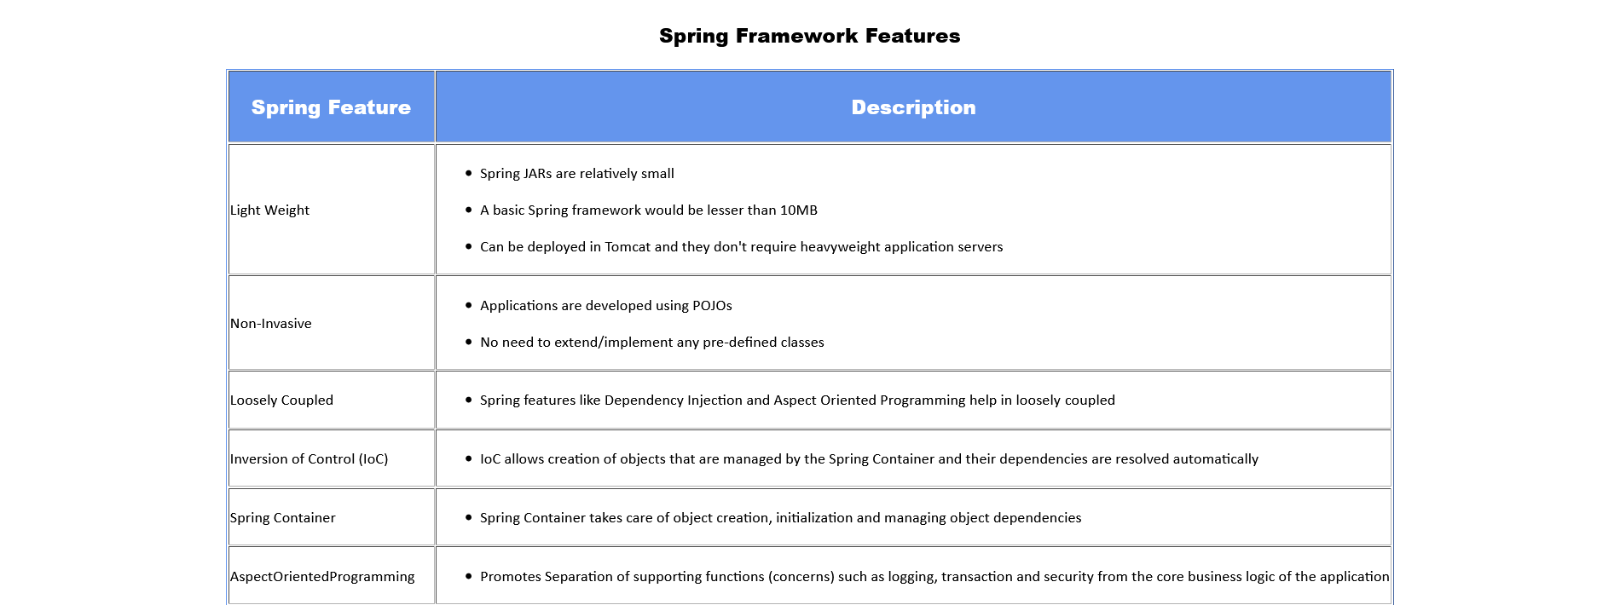

Slide 17
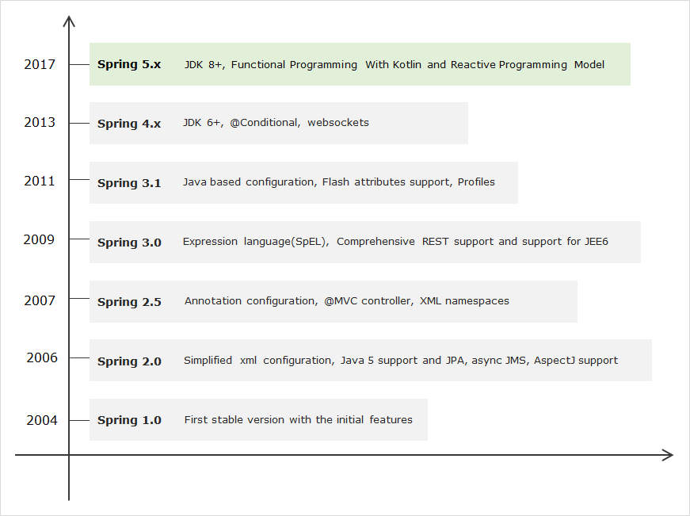
Over the last decade, the Spring Framework has grown dramatically. So, it is worthy to have a look at its evolution. The following image depicts the important features that have come along with each release of Spring, leading up to Spring Framework 5.0.

Slide 18
Current version of Spring Framework is 5.x. It has been enhanced with new features keeping core concepts same as Spring 4.x. At high level, the new features of Spring Framework 5.x are:
JDK baseline update
Core framework revision
Reactive Programming Model : Introduces a new non-blocking web framework called Spring WebFlux
Functional programming using Kotlin language support
Testing improvements by supporting integration with JUnit5
Let us look at Spring core relevant changes in detail:
JDK baseline update
The entire Spring framework 5.x code base runs on Java 8 and designed to work with Java 9. Therefore, Java 8 is the minimum requirement to work on Spring Framework 5.x.
Core framework revision
The core Spring Framework 5.x has been revised, one of the main change is that Spring comes with its own commons logging through spring-jcl jar instead of standard Commons Logging.
There are few more changes in Spring 5.x with respect to library support and discontinued support.

Slide 19
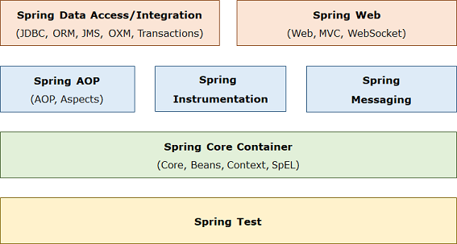
Spring is organized in a modular fashion. The developer can pick and choose the modules as per the need for building an enterprise application. Spring Framework 5.x has the following key module groups:
Spring Core Container: This module provides the Spring IoC container and Dependency Injection features.
Spring Data Access/Integration: This module provide support to access database in Spring applications.
Spring Web: This modules provide support to create web applications.
Spring AOP: This module supports aspect oriented programming implementation.
Spring Messaging: This module provides support for integrating Spring applications with messaging systems.
Spring Test: This module supports testing of Spring applications using JUnit or TestNG.

Slide 20
The Spring Core Container has the following modules:
Core: This is the key module of Spring Framework which provides fundamental support on which all other modules of the framework are dependent.
Bean: This module provide basic Spring IoC container called BeanFactory.
Context: This module provides Spring IoC container called ApplicationContext which extends the features of BeanFactory container and provides additional features for enterprise application development.
Spring Expression Language (SpEL): This module is used for querying/manipulating object value.

Slide 21
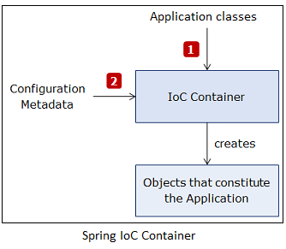
Introduction to Spring IoC Container
Spring framework provides a container for dependency injection. This container is called as Spring IoC container. It creates, initializes and injects the required objects. These objects whose life cycles are managed by Spring are called as Spring beans or beans. The Spring container needs information about objects of which class to create and how to wire them together. This information is called as configuration metadata. It can be provided in following ways:
XML configuration
Java-based configuration
Java Annotation-based configuration
Spring container reads the application classes using configuration metadata and then creates and wires beans in it as shown below:

Slide 22
The Spring IoC container is represented by the following interfaces:
BeanFactory interface: It represents container which provides basic functionalities. It instantiates bean whenever asked for by the client application. Using its getBean() method, you can get instances of beans. It instantiates bean objects only when getBean() method is called.
ApplicationContext interface: It extends BeanFactory interface and provides additional functionalities to support enterprise application development. It instantiates all beans when container is loaded. There are many implementations of this interface. Some commonly used implementation classes are as follows:
ClassPathXmlApplicationContext : It is used to process XML-based configuration metadata.
AnnotationConfigApplicationContext : It is used to process Java‐based configuration metadata.
Now, let us see how to configure Spring IoC container and use it.

Slide 23
Configuring and using Spring IoC Container
The Java-based configuration metadata is provided in Java class using following annotations:
@Configuration : The Java configuration class is marked with this annotation. This annotation identifies this as a configuration class, and it’s expected to contain details on beans that are to be created in the Spring application context.
@Bean : This annotation is used to declare a bean. The methods of configuration class that creates an instance of the desired bean are annotated with this annotation. These methods are called by Spring container during bootstrap and the values returned by these methods are treated as Spring beans. By default, only one bean instance is created for a bean definition by the Spring Container, and that instance is used by the container for the whole application lifetime.
For example, the CustomerLoginRepositoryImpl class can be configured in a Java class using the above annotations as follows :

Slide 24
@Configuration
public class SpringConfig {
@Bean
public CustomerLoginRepository customerLoginRepository() {
return new CustomerLoginRepositoryImpl();
}
}
By default, the bean name is same as the name of method in which bean is configured. So, in above code bean name is customerLoginRepository . If you want to change the bean name then you can either rename the method or provide a different name with the name attribute as follows:
@Bean(name="customerRepository")
public CustomerLoginRepository customerLoginRepository() {
return new CustomerLoginRepositoryImpl();
}

Slide 25
The CustomerLoginRepositoryImpl bean has no dependencies of its own but CustomerLoginServiceImpl class depends on CustomerRepository. So, you need to wire the dependencies in configuration class. The simplest way to do this is to refer the referenced bean’s method as follows:
@Bean
public CustomerLoginService customerLoginService() {
return new CustomerLoginServiceImpl(customerLoginRepository());
}
@Bean(name="customerRepository")
public CustomerLoginRepository customerLoginRepository() {
return new CustomerLoginRepositoryImpl();
}

Slide 26
So far, you have learnt that beans need to be configured in configuration class but in Java annotation-based configuration, there is no need to explicitly configure the bean. Spring automatically scans, detects and instantiates the beans from the specified package through component scanning. It looks for classes annotated with following annotations:
@Component : It is a general purpose annotation to mark a class as Spring bean.
​@Component
public class CustomerLoginController{
//rest of the code
}
@Service - It is used to define a service layer Spring bean. It is specialization of the @Component annotation for the service layer.
@Service
public class CustomerLoginSeviceImpl implements CustomerLoginService {
//rest of the code
}

Slide 27
@Repository - It is used to define a persistence layer Spring bean. It is specialization of the @Component annotation for the persistence layer.
​@Repository
public class CustomerLoginRepositoryImpl implements CustomerLoginRepository {
//rest of the code
}
@Controller - It is used to defined a web component. It is specialization of the @Component annotation for the presentation layer.
​@Controller
public class CustomerLoginController {
//rest of the code
}
By default, the bean name is same as class name with a lowercase initial character. Therefore, the above defined beans have the names customerLoginController, customerLoginServiceImpl and customerLoginRepositoryImpl. You can also give specific name to a bean with a value attribute of above annotations as follows:

Slide 28
​@Repository(value="customerLogin")
public class CustomerLoginRepositoryImpl implements CustomerLoginRepository {
//rest of the code
}
The component scanning isn’t enabled by default. You have to annotate configuration class with @ComponentScan annotation to enable component scanning as follows:
@Configuration
@ComponentScan
public class SpringConfig {
}
In the above code, Spring will scan the package that contains SpringConfig class and it sub-packages for beans. But if you want to scan a different package or multiple packages then you can specify this with the basePackages attribute as follows:

Slide 29
@Configuration
@ComponentScan(basePackages = "com.hnd.service com.hnd.repository")
public class SpringConfig {
}
In above code, the Spring will scan com.hnd.service and com.hnd.repository package and its sub-packages for beans.
If bean in your application are not having any dependencies, then component scanning alone works but if beans have dependencies, then you have to inject dependencies in your component-scanned beans. For this you have to do autowiring of dependencies.
You will learn this in the next module.

Slide 30
ApplicationContext can be loaded using AnnotationConfigApplicationContext class as follows:
ApplicationContext ctx = new AnnotationConfigApplicationContext(SpringConfig.class);
The getBean() method is used to access a particular bean by specifying its class as follows:
UserService userService = ctx.getBean(CustomerLoginServiceImpl.class);
The bean name which is the name of the method in which bean is configured can also be used to access a particular bean as follows:
UserService userService = (UserService) ctx.getBean("customerLoginServiceImpl");

Slide 31
Java-based configuration - Demo
Objective:
To understand how to define configuration metadata using Java-based configuration and use ApplicationContext.
Steps:
Step 1: Create a new Maven project using Eclipse.
Step 2: Add the following Spring dependency and properties in pom.xml:
<dependencies>
<dependency>
<groupId>org.springframework</groupId>
<artifactId>spring-context</artifactId>
<version>5.3.18</version>
</dependency>
</dependencies>
<properties>
<maven.compiler.target>17</maven.compiler.target>
<maven.compiler.source>17</maven.compiler.source>
</properties>

Slide 32
Step 3: Create the following Spring bean in com.hnd.bean package:
package com.hnd.bean;
public class WelcomeBean {
public String printWelcome() {
return "Welcome to Spring";
}
}
Step 4: Create the following configuration file in com.hnd.configuration package:
package com.hnd.configuration;
import org.springframework.context.annotation.Configuration;
import org.springframework.context.annotation.Bean;
import com.hnd.bean.WelcomeBean;
@Configuration
public class SpringConfig {
@Bean
public WelcomeBean welcomeBean() {
return new WelcomeBean();
}
}

Slide 33
Step 5: Create the following UserInterface class in com.hnd.ui package with the main method and instantiate the Spring container using configuration class you created in the previous step as the constructor argument. Retrieve the WelcomeBean via getBean() method and use it.
package com.hnd.ui;
import org.apache.commons.logging.Log;
import org.apache.commons.logging.LogFactory;
import org.springframework.context.ApplicationContext;
import org.springframework.context.annotation.AnnotationConfigApplicationContext;
import com.hnd.bean.WelcomeBean;
import com.hnd.configuration.SpringConfig;
public class UserInterface {
public static final Log LOGGER = LogFactory.getLog(UserInterface.class);
public static void main(String[] args) {
ApplicationContext applicationContext = new AnnotationConfigApplicationContext(SpringConfig.class);
WelcomeBean welcomeBean = applicationContext.getBean(WelcomeBean.class);
LOGGER.info(welcomeBean.printWelcome());
}
}

Slide 34

Step 6: Run the UserInterface class created in the previous step. You will get the following output:

Slide 35
Java-Annotation based configuration - Demo
Objective:
To understand how to define configuration metadata using Java-Annotation based configuration and use ApplicationContext
Steps:
Step 1: Create a new Maven project using Eclipse.
Step 2: Add the following Spring dependency in pom.xml:
<dependencies>
<dependency>
<groupId>org.springframework</groupId>
<artifactId>spring-context</artifactId>
<version>5.3.18</version>
</dependency>
</dependencies>
<properties>
<maven.compiler.target>17</maven.compiler.target>
<maven.compiler.source>17</maven.compiler.source>
</properties>

Slide 36
Step 3: Create the following Spring bean in com.hnd.bean package:
package com.hnd.bean;
import org.springframework.stereotype.Component;
@Component
public class WelcomeBean {
public String printWelcome() {
return "Welcome to Spring";
}
}
Step 4: Create the following configuration file in com.hnd.configuration package:
package com.hnd.configuration;
import org.springframework.context.annotation.ComponentScan;
import org.springframework.context.annotation.Configuration;
@Configuration
@ComponentScan(basePackages = "com.hnd.bean")
public class SpringConfig {
}

Slide 37
Step 5: Create the following UserInterface class in com.hnd.ui package with the main method and instantiate the Spring container using configuration class you created in the previous step as the constructor argument. Retrieve the WelcomeBean via getBean() method and use it.
package com.hnd.ui;
import org.apache.commons.logging.Log;
import org.apache.commons.logging.LogFactory;
import org.springframework.context.ApplicationContext;
import org.springframework.context.annotation.AnnotationConfigApplicationContext;
import com.hnd.bean.WelcomeBean;
import com.hnd.configuration.SpringConfig;
public class UserInterface {
public static final Log LOGGER = LogFactory.getLog(UserInterface.class);
public static void main(String[] args) {
ApplicationContext applicationContext = new AnnotationConfigApplicationContext(SpringConfig.class);
WelcomeBean welcomeBean = (WelcomeBean) applicationContext.getBean(WelcomeBean.class);
LOGGER.info(welcomeBean.printWelcome());
}
}

Slide 38

Step 6: Run the UserInterface class created in the previous step. You will get the following output:

Slide 39
Best Practices in Java-Annotation based Configuration
Some of the best practices that should be followed in Java-Annotation based configuration are:
Use specialized stereotypes and NOT generic stereotype
As you have seen previously, @Component is a 'generic' stereotype for any Spring-managed bean or component. We also derive @Service, @Repository and @Controller from @Component, which are 'specialized' stereotypes used for classes implementing Service, Persistence and Controller layers respectively.
@Component can be used interchangeably with any of the above derived specific stereotypes and there will not be any significant issue or complication to the application. However, it is a best practice to use the specific stereotypes for their respective layer implementations (which is @Service for Service Layer, @Repository for Persistence Layer and @Controller for Controller Layer).

Slide 40
Introduction to Autowiring
If one bean class is dependent on another bean class, then the bean dependencies need to be explicitly defined in your configuration class but you can let the Spring IoC container to inject the dependencies into dependent bean classes without defining in your configuration class. This is called as autowiring.
To do autowiring, you can use @Autowired annotation. This annotation allows Spring IoC container to resolve and inject dependencies into your bean. It can be applied to attributes, constructors, setter methods of a bean class.
Now, let us see how to use @Autowired annotation.

Slide 41
Using @Autowired annotation
You can use @Autowired annotation directly on properties. For example, in the following code, CustomerLoginRepository is injected in CustomerLoginServiceImpl class using @Autowired annotation:
public class CustomerLoginServiceImpl implements CustomerLoginService {
@Autowired
private CustomerLoginRepository customerLoginRepository;
public String authenticateCustomer(CustomerLoginDTO customerLogin) throws hndBankException {
try {
String toRet = null;
CustomerLoginDTO customerLoginFromDao = customerLoginRepository
.getCustomerLoginByLoginName(customerLogin.getLoginName());
if (customerLogin.getPassword().equals(customerLoginFromDao.getPassword())){
toRet = "SUCCESS";
}else{
throw new hndBankException("Service.WRONG_CREDENTIALS");
}
return toRet;
}catch(hndBankException exception) {
Log LOGGER = LogFactory.getLog(this.getClass());
LOGGER.error(exception.getMessage(),exception);
throw exception;
}
}
}

Slide 42
In above code, Spring container will perform dependency injection using the Java Reflection API. It will search for the class which implements CustomerLoginRepository interface and injects its object. The dependencies which are injected using @Autowired should be available to Spring container when the dependent bean object is created. If the container does not find a bean for autowiring, it will throw NoSuchBeanDefinitionException exception.
If more than one bean of the same type are available in the container, then the framework throws an exception indicating that more than one bean is available for autowiring. To handle this, @Qualifier annotation is used as follows:
public class CustomerLoginServiceImpl implements CustomerLoginService {
@Autowired
@Qualifier("jdbcRepository")
private CustomerLoginRepository customerLoginRepository;
}
In the above code snippet, if CustomerLoginRepository has multiple implementations then the implementation which is registered in container with name jdbcRepository will be injected.
Autowiring is done only for dependencies to other beans. It doesn't work for properties such as primitive data types, String, Enum, etc. For such properties, you can use the @Value annotation (not covered as part of this course).
Now, let us see how to use @Autowired annotation on setter methods.

Slide 43
The @Autowired annotation can also be used on setter methods. This is called as Setter Injection. For example, in the following code, CustomerLoginRepository is injected in CustomerLoginServiceImpl class using @Autowired annotation on the setter method:
public class CustomerLoginServiceImpl implements CustomerLoginService {
private CustomerLoginRepository customerLoginRepository;
@Autowired
public void setCustomerLoginRepository(CustomerLoginRepository customerLoginRepository) {
this.customerLoginRepository = customerLoginRepository;
}
public String authenticateCustomer(CustomerLoginDTO customerLogin) throws hndBankException {

Slide 44
try {
String toRet = null;
CustomerLoginDTO customerLoginFromDao = customerLoginRepository
.getCustomerLoginByLoginName(customerLogin.getLoginName());
if (customerLogin.getPassword().equals(customerLoginFromDao.getPassword())){
toRet = "SUCCESS";
}else{
throw new hndBankException("Service.WRONG_CREDENTIALS");
}
return toRet;
}catch(hndBankException exception) {
Log LOGGER = LogFactory.getLog(this.getClass());
LOGGER.error(exception.getMessage(),exception);
throw exception;
}
}
}
In above code snippet, the Spring IoC container will call setter method for injecting the dependency.

Slide 45
The @Autowired annotation can also be used on constructor. This is called as Constructor Injection. For example, in the following code, CustomerLoginRepository is injected in CustomerLoginServiceImpl class using @Autowired annotation on constructor:
public class CustomerLoginServiceImpl implements CustomerLoginService {
private CustomerLoginRepository customerLoginRepository;
@Autowired
public CustomerLoginServiceImpl(CustomerLoginRepository customerLoginRepository ) {
this.customerLoginRepository = customerLoginRepository ;
}
public String authenticateCustomer(CustomerLoginDTO customerLogin) throws hndBankException {

Slide 46
try {
String toRet = null;
CustomerLoginDTO customerLoginFromDao = customerLoginRepository
.getCustomerLoginByLoginName(customerLogin.getLoginName());
if (customerLogin.getPassword().equals(customerLoginFromDao.getPassword())){
toRet = "SUCCESS";
}else{
throw new hndBankException("Service.WRONG_CREDENTIALS");
}
return toRet;
}catch(hndBankException exception) {
Log LOGGER = LogFactory.getLog(this.getClass());
LOGGER.error(exception.getMessage(),exception);
throw exception;
}
}
}
In the above code snippet, the Spring IoC container will call constructor for injecting the dependency.

Slide 47
Autowiring - Demo
Objective:
To implement Customer Login user story using autowiring and Java annotation based configuration.
Steps:
Step 1: Create a new Maven project using Eclipse.
Step 2: Add the following Spring dependency and properties in pom.xml:
<dependencies>
<dependency>
<groupId>org.springframework</groupId>
<artifactId>spring-context</artifactId>
<version>5.3.18</version>
</dependency>
<dependency>
<groupId>org.apache.logging.log4j</groupId>
<artifactId>log4j-api</artifactId>
<version>2.17.1</version>
</dependency>

Slide 48
<dependency>
<groupId>org.apache.logging.log4j</groupId>
<artifactId>log4j-core</artifactId>
<version>2.17.1</version>
</dependency>
</dependencies>
<properties>
<maven.compiler.target>17</maven.compiler.target>
<maven.compiler.source>17</maven.compiler.source>
</properties>
Step 3: Create a package named com.hnd.dto, and then create the following Java class in it:
package com.hnd.dto;
public class CustomerLoginDTO {
private String loginName;
private String password;
public String getLoginName() {
return loginName;
}

Slide 49
public void setLoginName(String loginName) {
this.loginName = loginName;
}
public String getPassword() {
return password;
}
public void setPassword(String password) {
this.password = password;
}
@Override
public String toString() {
return "CustomerLoginDTO [loginName=" + loginName + ", password=" + password + "]";
}
}
Step 4: Create a package named com.hnd.repository, and then create the following interface in it:

Slide 50
package com.hnd.repository;
import com.hnd.dto.CustomerLoginDTO;
public interface CustomerLoginRepository {
public CustomerLoginDTO getCustomerLoginByLoginName(String loginName);
}
Step 5: Create the following class in com.hnd.repository package:
package com.hnd.repository;
import java.util.HashMap;
import java.util.Map;
import org.springframework.stereotype.Repository;
import com.hnd.dto.CustomerLoginDTO;
@Repository(value="customerLoginRepository")
public class CustomerLoginRepositoryImpl implements CustomerLoginRepository {
public CustomerLoginDTO getCustomerLoginByLoginName(String loginName) {
Map<String, String> customerCredentials = new HashMap<String, String>();
customerCredentials.put("robin", "robin123");
customerCredentials.put("harry", "harry123");
customerCredentials.put("garry", "garry123");
customerCredentials.put("monica", "mocica123");
CustomerLoginDTO customerLogin = new CustomerLoginDTO();
customerLogin.setLoginName(loginName);
customerLogin.setPassword(customerCredentials.get(loginName));
return customerLogin;
}
}

Slide 51
Step 6: Create a package named com.hnd.service and then create the following interface in it:
package com.hnd.service;
import com.hnd.dto.CustomerLoginDTO;
import com.hnd.exception.hndBankException;
public interface CustomerLoginService {
public String authenticateCustomer(CustomerLoginDTO customerLogin) throws hndBankException;
}
Step 7: Create the following class in com.hnd.service package:
package com.hnd.service;
import org.apache.commons.logging.Log;
import org.apache.commons.logging.LogFactory;
import org.springframework.beans.factory.annotation.Autowired;
import org.springframework.stereotype.Service;
import com.hnd.dto.CustomerLoginDTO;
import com.hnd.exception.hndBankException;
import com.hnd.repository.CustomerLoginRepository;

Slide 52
@Service(value="customerLoginService")
public class CustomerLoginServiceImpl implements CustomerLoginService {
@Autowired
private CustomerLoginRepository customerLoginRepository;
public String authenticateCustomer(CustomerLoginDTO customerLogin) throws hndBankException {
try {
String toRet = null;
CustomerLoginDTO customerLoginFromDao = customerLoginRepository
.getCustomerLoginByLoginName(customerLogin.getLoginName());
if (customerLogin.getPassword().equals(customerLoginFromDao.getPassword())){
toRet = "SUCCESS";
}else{
throw new hndBankException("Service.WRONG_CREDENTIALS");
}
return toRet;
}catch(hndBankException exception) {
Log LOGGER = LogFactory.getLog(this.getClass());
LOGGER.error(exception.getMessage(),exception);
throw exception;
}
}
}

Slide 53
Step 8: Create a package named com.hnd.controller and then create the following class in it:
package com.hnd.controller;
import org.springframework.beans.factory.annotation.Autowired;
import org.springframework.stereotype.Controller;
import com.hnd.dto.CustomerLoginDTO;
import com.hnd.exception.hndBankException;
import com.hnd.service.CustomerLoginService;
@Controller(value="customerLoginController")
public class CustomerLoginController {
@Autowired
private CustomerLoginService customerLoginService;
public String authenticateCustomer(CustomerLoginDTO customerLogin) throws hndBankException {
return customerLoginService.authenticateCustomer(customerLogin);
}
}

Slide 54
Step 9: Create a package named com.hnd.configuration and create following Java‐based bean configuration class in it:
package com.hnd.configuration;
import org.springframework.context.annotation.ComponentScan;
import org.springframework.context.annotation.Configuration;
import org.springframework.context.annotation.PropertySource;
@Configuration
@PropertySource("classpath:messages.properties")
@ComponentScan(basePackages="com.hnd.service com.hnd.repository com.hnd.controller")
public class SpringConfig {
}
Step 10: Create the following message.properties file in src/main/resources folder:
Service.WRONG_CREDENTIALS=Login denied. Invalid credentials.
SUCCESS=Customer logged in successfully!!

Slide 55
Step 11: Spring will configure log4j2 when the required dependency is added in pom.xml and also the log4j2.properties is added in src/main/resources.
Step 12: Create a package named com.hnd.ui and create the following UserInterface class with the main method in it:
package com.hnd.ui;
import org.apache.commons.logging.Log;
import org.apache.commons.logging.LogFactory;
import org.springframework.context.ApplicationContext;
import org.springframework.context.annotation.AnnotationConfigApplicationContext;
import org.springframework.core.env.Environment;
import com.hnd.configuration.SpringConfig;
import com.hnd.controller.CustomerLoginController;
import com.hnd.dto.CustomerLoginDTO;
import com.hnd.exception.hndBankException;

Slide 56
public class UserInterface {
public static final Log LOGGER = LogFactory.getLog(UserInterface.class);
public static void main(String[] args) throws Exception {
Environment environment=null;
ApplicationContext applicationContext =null;
try{
applicationContext = new AnnotationConfigApplicationContext(SpringConfig.class);
environment=applicationContext.getEnvironment();
CustomerLoginController customerLoginController = applicationContext
.getBean(CustomerLoginController.class);
CustomerLoginDTO customerLogin = new CustomerLoginDTO();
customerLogin.setLoginName("harry");
customerLogin.setPassword("harry123");
customerLoginController.authenticateCustomer(customerLogin);
LOGGER.info(environment.getProperty("SUCCESS"));
}catch(hndBankException exception){
LOGGER.error(environment.getProperty(exception.getMessage()));
}
}
}

Slide 57


Note: hndBankException class is already implented.
Step 13: Run the UserInterface class created in the previous step. You will get the following output:
For valid input, the output will be logged in console as:
For invalid input, the output will be logged in console as :

Slide 58
Best Practices in Spring Framework
A best practice that should be followed while developing with Spring Framework is:
Use only managed beans and avoid directly instantiating a class.
As you would have already noticed that we have not directly instantiated a class when it is used as a managed bean as instantiating it directly using the new is considered to be a bad practice.
@Controller(value="customerLoginController")
public class CustomerLoginController {
//This is a bad practice and should be avoided
private CustomerLoginService customerLoginService = new CustomerLoginServiceImpl();
public String authenticateCustomer(CustomerLoginDTO customerLogin) throws Exception {
String result = customerLoginService.authenticateCustomer(customerLogin);
return result;
}
}

Slide 59
What could be the reason for this?
When a class is used to instantiate a managed bean in Spring, it benefits from different features of the framework. For example, each bean in Spring is a component and it can take advantage of all services. Also, the bean is eligible for injection into other objects.
Hence, as a best practice, use only managed beans. Thus, the developers have to rely on injecting the bean.
@Controller(value="customerLoginController")
public class CustomerLoginController {
@Autowired
private CustomerLoginService customerLoginService;
public String authenticateCustomer(CustomerLoginDTO customerLogin) throws Exception {
String result = customerLoginService.authenticateCustomer(customerLogin);
return result;
}
}
Whenever different instances of the same class is needed, Spring bean can be scoped as prototype.

